Slide 1

Module 14 – Idea & Proposal
Jan 2018
Notes:
[STANDARD SLIDE: L300 (animated)]
You can change out the photo with any image from Getty Images in DropBox.
If the main title is shorter, you can make the font larger.
You may have to move the title text around depending on the photo. Make sure the text is readable against the background photo.
You can change the background color for the rectangle in the bottom-right corner to look better against the background. Choose a Micro Focus color at 25% transparency.
=========================
Note to Narrator or Reader: [PRESS] indicates press the Page Down key to show the animation
=========================
Hello and Welcome to the [COURSE_NAME] Technical Overview Training, Level 300.
In this course you’ll gain a high-level understanding of the essentials of [PRODUCT_NAME].
[PRESS] If you want to download this presentation and save it on your own system, click the Tools & Help icon in the bottom-right corner of your window and select Download.
Or, if you want to access the PPT slides and speaker notes for future reference, go to the Attachments tab in your window click to download the presentation.

Slide 2
Idea and Proposal Management

Slide 3
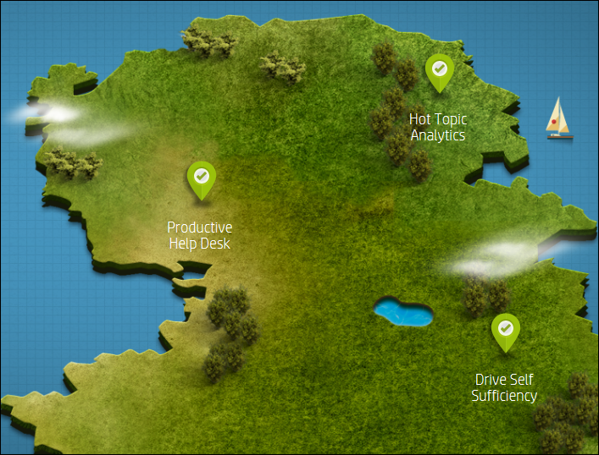
Idea and Proposal Management
Objectives:
Overview of Idea & Proposal Management.
Understand the benefit of capturing Ideas from the business users.
Know how to log a new idea.
Understand how an idea can become a Proposal or Change.
Describe how a Proposal can be actioned.
Navigate Proposal Analytics.

Slide 4
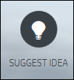
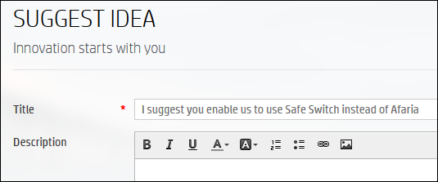
Idea and Proposal Management
Ideation is the creative process of generating, developing, and communicating new ideas.
The Idea and Proposal Management module enables a company to directly collect feedback from the service consumer, which ensures continuous improvement of the IT service and drives innovation.
An Idea can then become a Proposal or a Change Request.
Business users can submit ideas from ESS portal
Notes:
Idea and Proposal Management
Service Anywhere users may come up with innovative ideas every now and then. No matter whether the ideas are aimed at improving the IT infrastructure, services, processes, or tools, you can always submit them through the Self-Service Portal or the Idea and Proposal Management module in HP Service Anywhere.
Ideation is the creative process of generating, developing, and communicating new ideas. The Idea and Proposal Management module enables a company to directly collect feedback from the service consumer, which ensures continuous improvement of the IT service and drives innovation.
With social collaboration, ideas can evolve to proposals or changes after being categorized, reviewed, and approved. When you have an approved idea in place, you can create a proposal or change record in Service Anywhere by simply a few clicks. When the proposal is created, you officially enter the project and portfolio management domain.

Slide 5
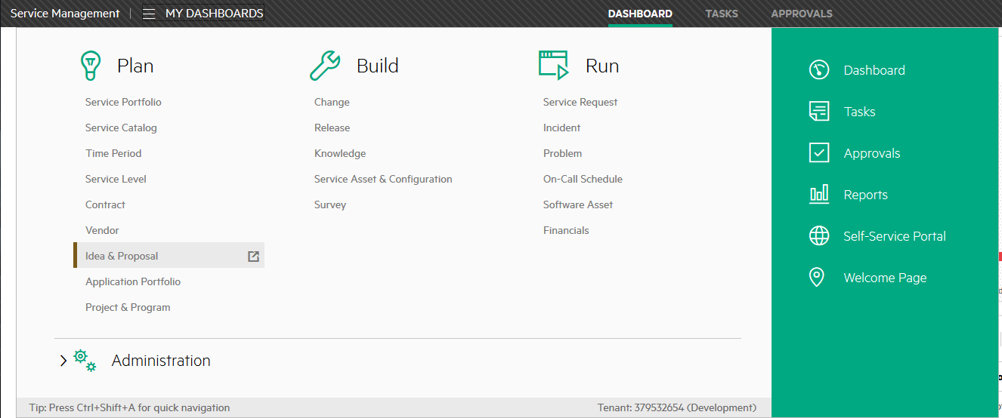
IT Agent Accessing Idea and Proposal Management
Idea and Proposal Management
From the Menu > Plan > Idea & Proposal
Roles
Self-Service Portal user, Idea reviewer, Idea administrator
Proposal creator, Proposal reviewer, Portfolio manager

Slide 6
Ideas

Slide 7
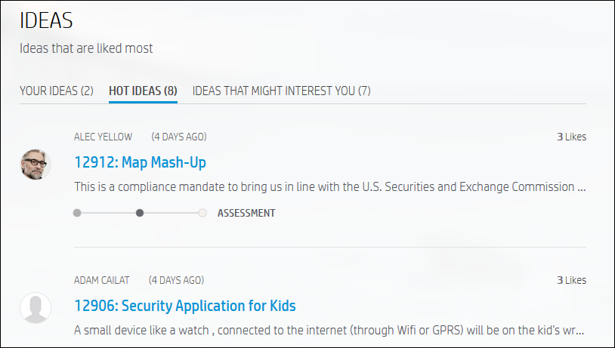
Hot Ideas in Self Service
Hot Ideas relevant for Business users
Self Service Hot ideas:
Shows those ideas which other business users like
Three most favorite ideas are shown in Hot Ideas
Refreshed every 24 hours
Click SEE ALL HOT IDEAS to show other liked ideas

Slide 8
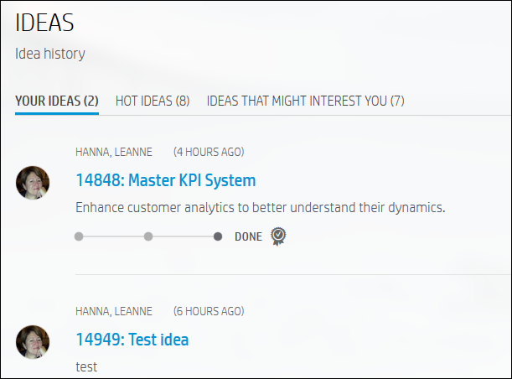
Ideas in Self Service
Ideas which may interest you which are based on your skills
Hot ideas
Ideas you have logged

Slide 9
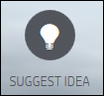
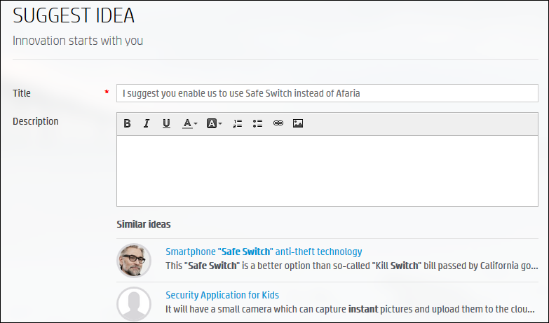
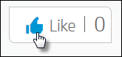
Ideas – Submitting a New Idea from ESS
When submitting an idea, similar ideas are shown as you type.
You can vote for an idea by displaying it and clicking the Like indicator and even add further comments.
Similar ideas are displayed

Slide 10
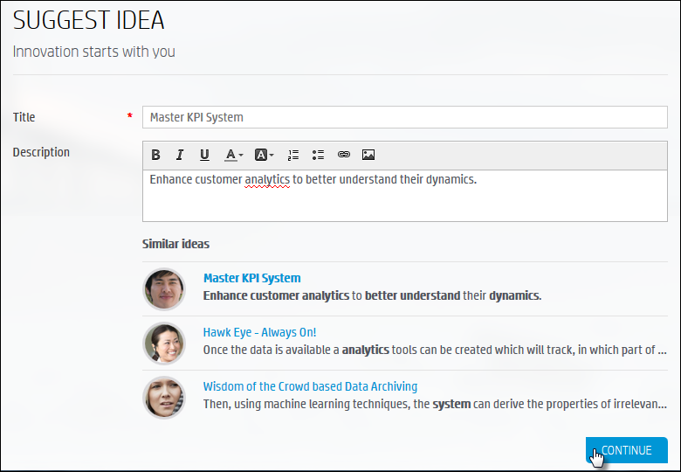
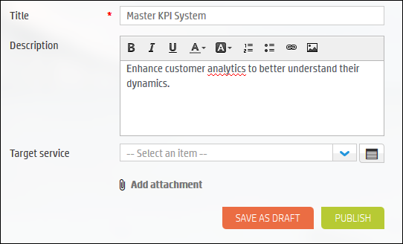
Ideas – Submitting a New Idea from ESS
Enter a Title, Description and click Continue. Save As Draft or Publish.

Slide 11
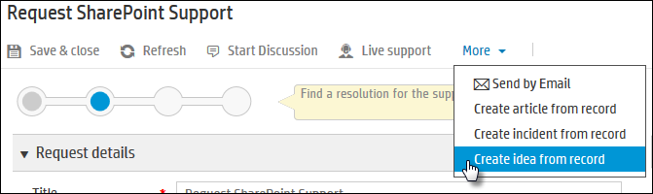
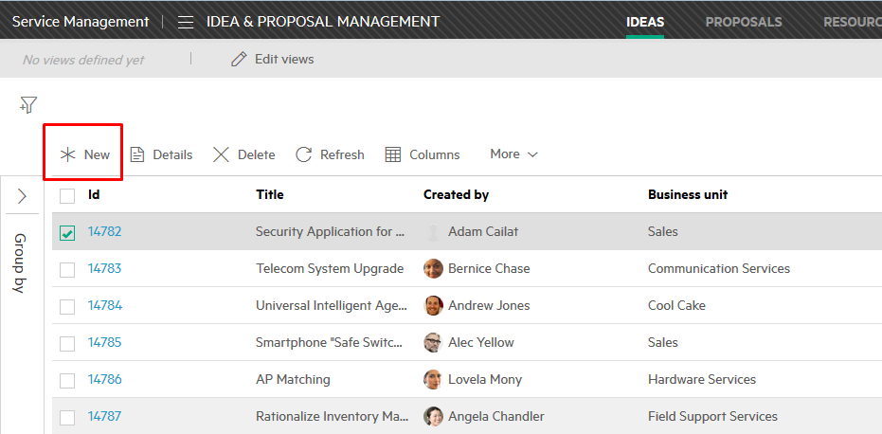
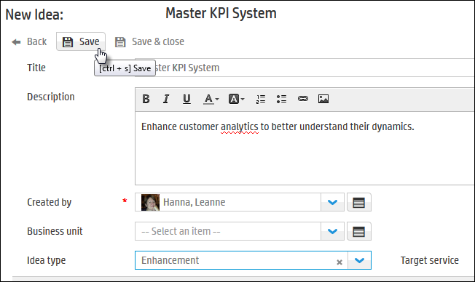
Ideas – Submitting a New Idea from IT Agent
Mega Menu > Plan > Idea & Proposal
From the Idea List, click New.
A new idea can even be created from a request

Slide 12
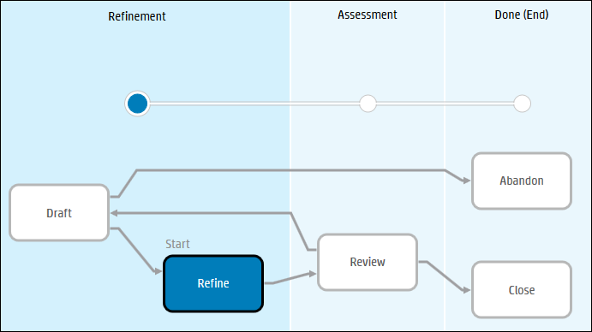
Idea Workflow
Mega Menu > Plan > Idea & Proposal
Idea reviewer reviews ideas and any approvers approve or reject. It is either marked and sent to a Proposal, a Change or rejected.
Idea creator submits the idea and updates with more information
Idea creator or reviewer further updates and may manually add approvers to approve the idea
Notes:
Idea Workflow
Draft – In ESS, if the idea creator clicks the Save as Draft button while creating an idea, the idea enters into the Draft phase. In this phase, the idea cannot be publicly viewed.
When the idea is ready to publish, the user who is creating this idea can manually transition the idea to the Refine phase so that the idea can be engaged in social activities.
The user who is creating this idea can manually transition the idea to the Abandon phase if the idea is not valid.
Refine - When the idea is submitted, the idea enters into the Refine phase. The result of the phase is the successful publication of an idea.
The idea creator can continue to work on the idea in this phase, while other users can also view and comment on this idea.
The idea reviewer can manually transition the idea to the Review phase if the idea is worth reviewing.
Review – In this phase, the Idea review performs reviewing actions, such as reviewing, categorizing, prioritizing, approving and then deciding which subsequent process comes next – to create a Proposal, create a Change or Reject the idea.
Close – The idea is completed. Possible results of this phase are:
A proposal or change have been created.
The idea is rejected without any implementation plan.
Abandon – The idea is abandoned by the user who created this idea.

Slide 13
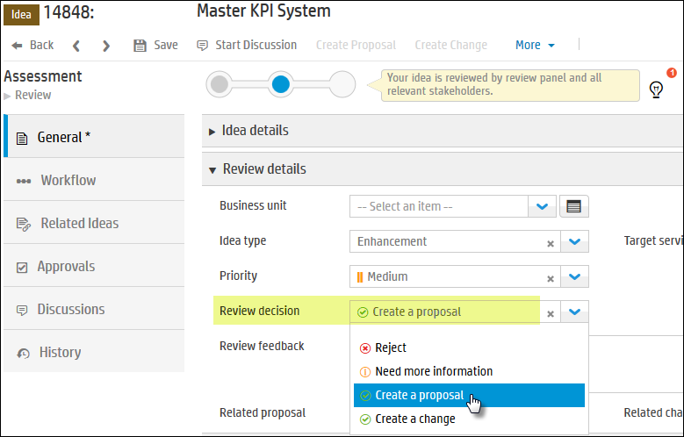
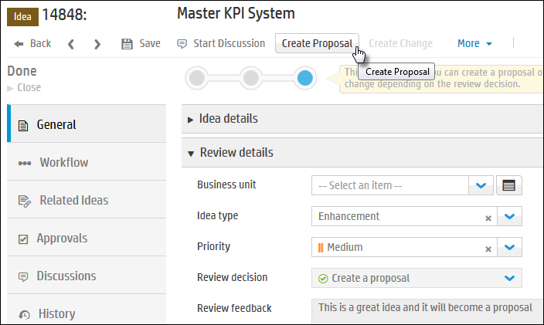
Creating a Proposal or Change from an Idea
When reviewing an idea, the reviewer makes a decision what the next process for the idea will be
Once saved, the reviewer can create a proposal or change.

Slide 14
Proposals

Slide 15
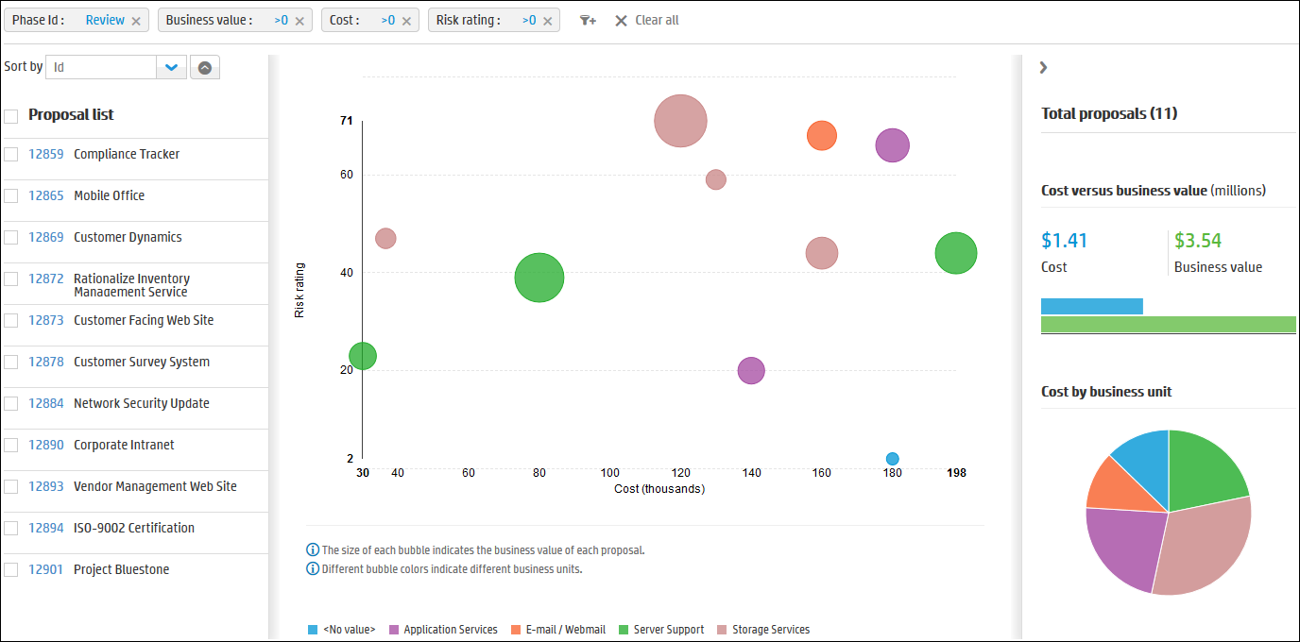
Proposal Management
Provides an easy way for Project Management to filter all proposals and decide which ones can become a project.

Slide 16
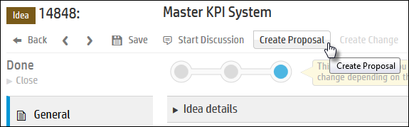
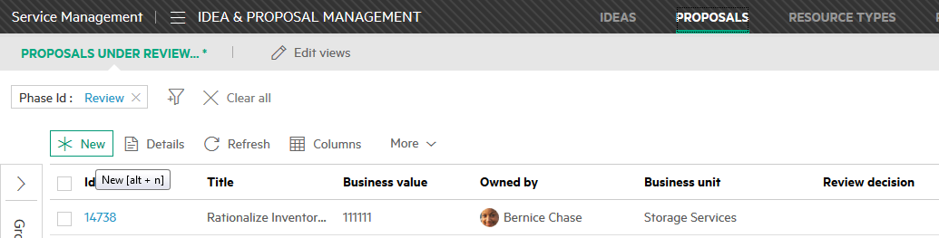
Creating a new Proposal
A Proposal can be created from an idea, the Proposal List or a request or change.

Slide 17
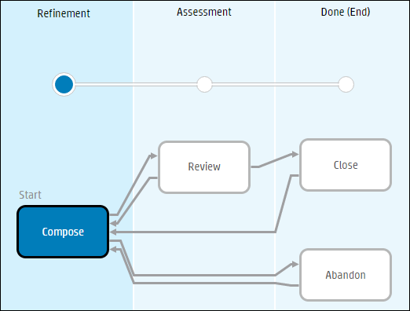
Proposal Workflow
Menu > Build > Idea & Proposal
Create a Proposal when you want to propose a candidate project and ask for the stakeholder’s review and approval.
Approved Proposals can later be implemented by other project management applications.
Proposal is created and information, such as business objective, cost, business value and risk are completed
Proposal reviewer reviews using Proposal Analytics to determine how to proceed with proposal (approve, reject, or more information)
Notes:
Proposal Workflow contains 3 phases:
Compose – This phase is where the proposal begins. It is composed with all details of the Proposal, including Business Objective, Cost, Business value, and Risk Rating.
Review – Proposal reviewer reviews and prioritizes proposals in this phase. He is using proposal analytics to understand how to proceed with the proposal. The proposal reviewer also needs to decide how to proceed with the proposal from one of the following actions:
Approve this proposal. Approved proposals can later be implemented by other project management applications.
Reject this proposal
Transition the proposal back to the Compose phase so that the proposal creator can provide more information
Close – This is the final stage in the workflow. Proposals are completed or returned to the Compose phase.
Abandon – The proposal is abandoned by the proposal creator and is inactive.

Slide 18
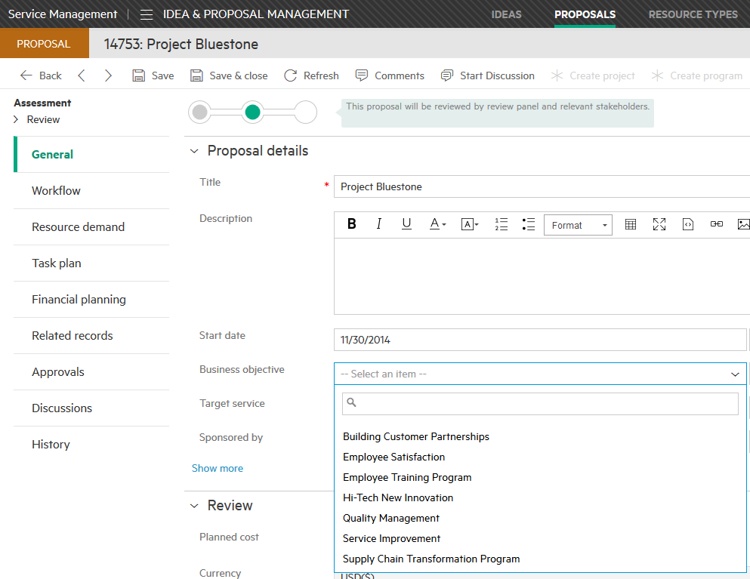
Proposal record – Proposal Details
Provides information on the proposal, including Business Unit and Business Objective of the Proposal.
Business Objectives are defined in the Business Objectives area of Idea & Proposal

Slide 19
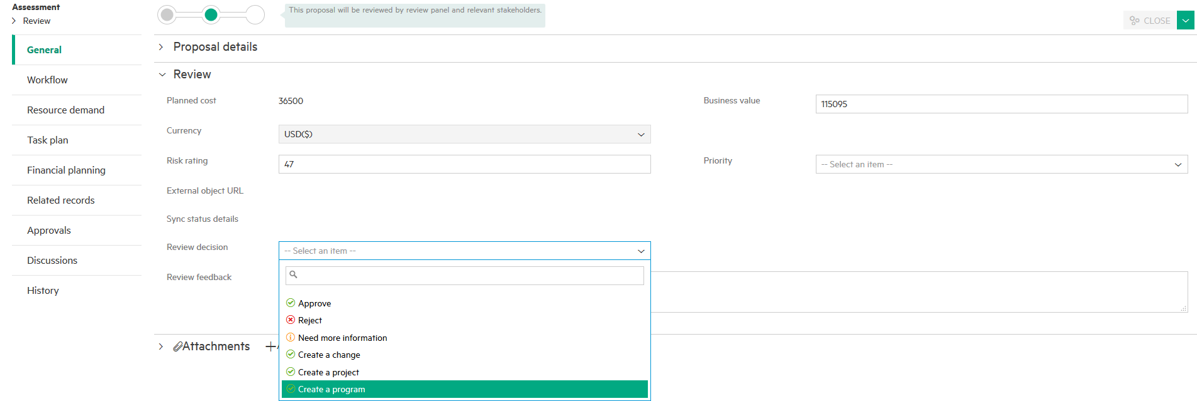
Proposal record – Review
Estimated monetary Value to the business
Provides information about the Proposal, and Review Decision.
Risk Rating is number between 0 to 100
Estimated Cost
Priority of Proposal
Review decision to Approve, Reject or more information
Notes:
Review a Proposal:
Cost – Enter the estimated cost of the proposed project.
Business Value – Enter the estimated value of this proposal to the business.
Currency – Specify the currency that you used when inputting the business value. By default, USD (US dollars) is selected.
Risk rating – Enter an integer from 0 to 100. 100 indicates the highest risk, and 0 indicates the lowest. The risk rating is also displayed in the proposal analytics view.
Proposals with lower risk might be considered and implemented first.
Priority – From the drop-down list, select one of the following options:
Critical
High
Medium
Low
When resources are limited, proposals with critical or high priority may be reviewed and implemented first.

Slide 20
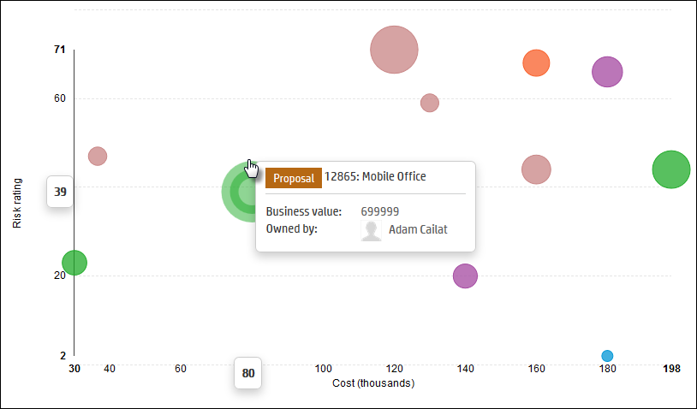
Proposal Analytics
Enables portfolio managers to analyse proposals and evaluate its business value to determine if the proposal will become a candidate project.
Each Proposal is a bubble in the Proposal Analytics bubble chart.
It uses the Proposal:
Cost
Risk
Business Value
The colour of the bubbles indicate the Business Unit
The bigger the size, the lower the cost, the lower the risk, is the better choice

Slide 21
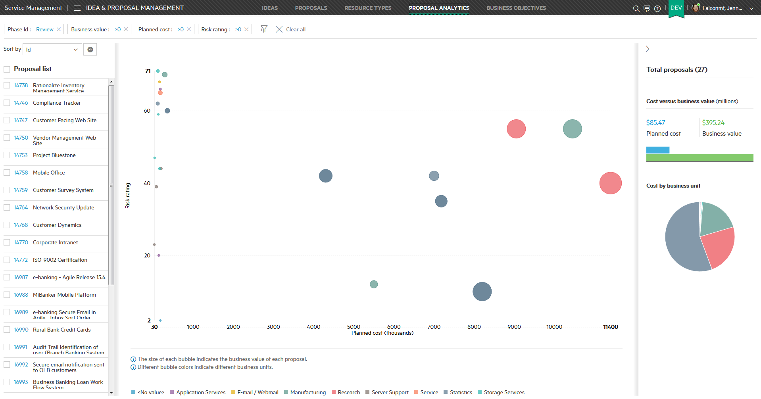
Proposal Analytics
Bubble size indicates the business value of the proposal
Summary Panel
Bubble Chart
Risk Rating
Hover over pie wedge to see business unit & cost
Cost of Proposal
Proposal List
Business Units

Slide 22


Demonstration

Slide 23
Lab
Practice the Idea&Proposal demo card

Slide 24
Lab Exercises

